Slide 1
Algorithms
Lecture #08
Dr.Sohail Aslam

Slide 2
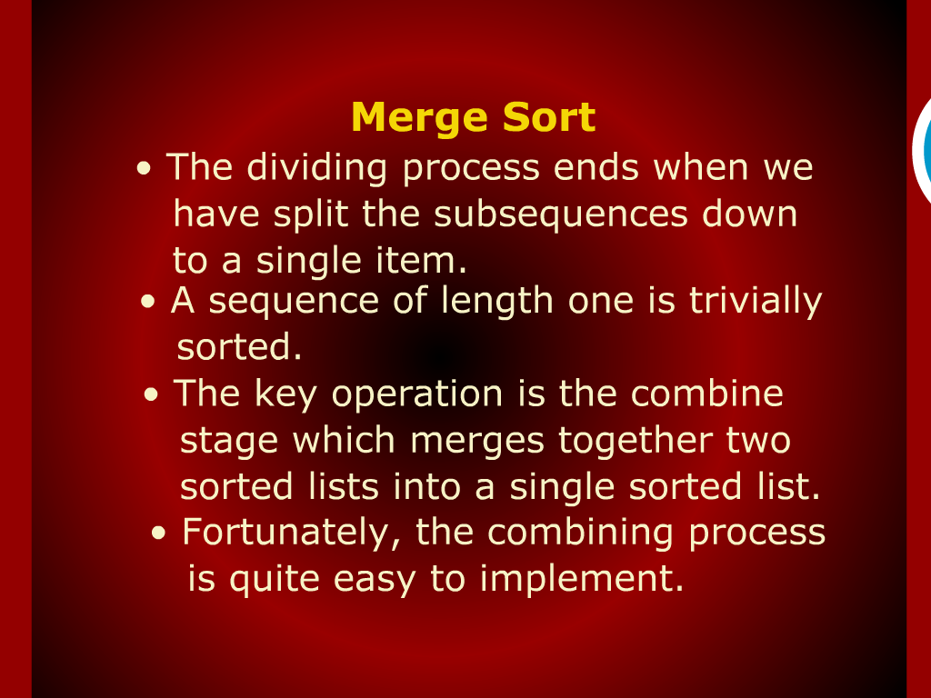
Merge Sort

Slide 3
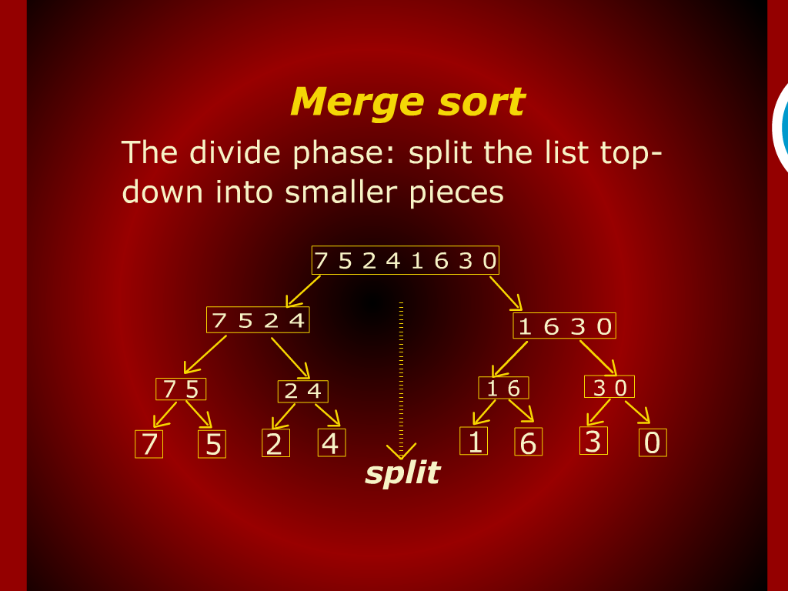
Merge Sort

Slide 4
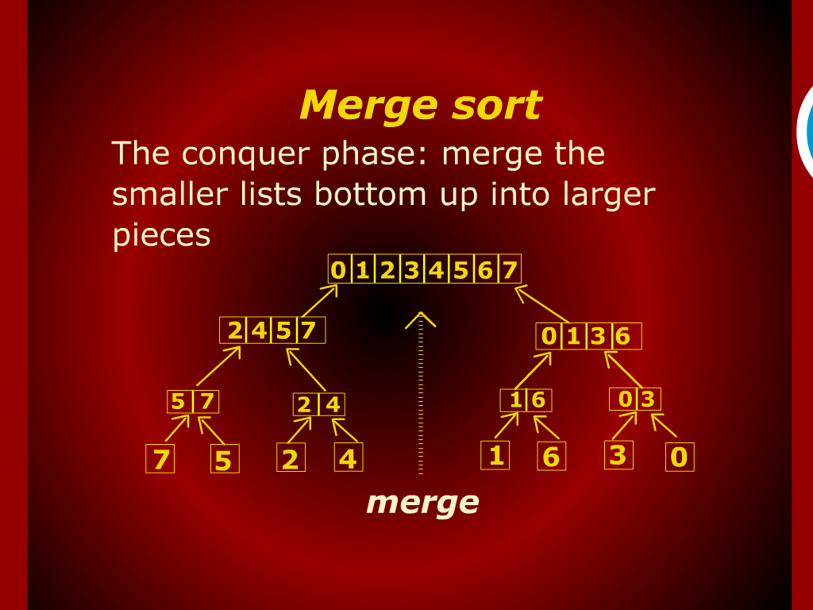
Merge Sort

Slide 5
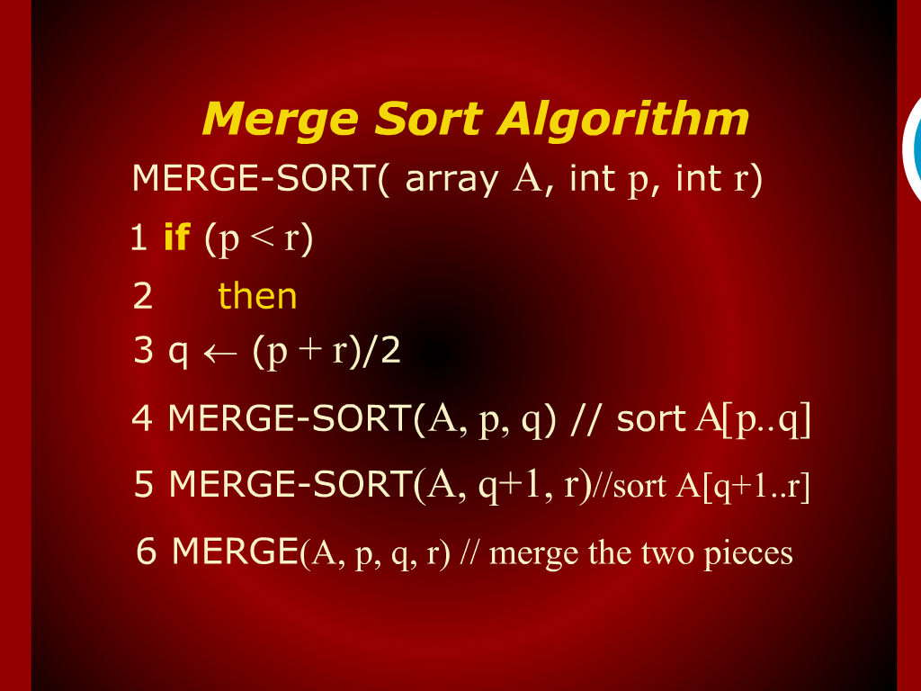
Merge Sort Algorithm

Slide 6
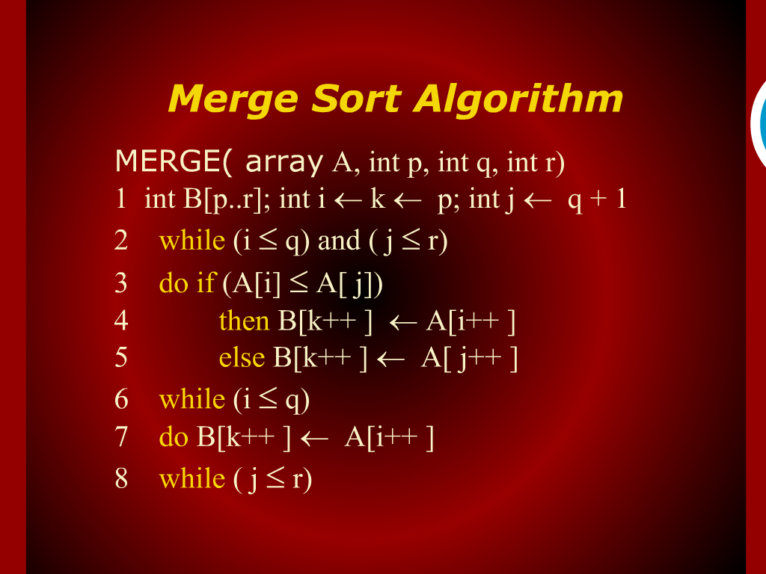
Merge Sort Algorithm

Slide 7
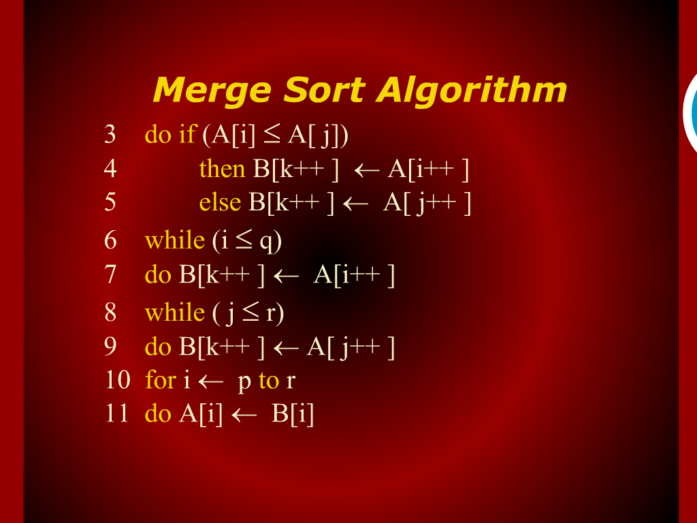
Merge Sort Algorithm

Slide 8
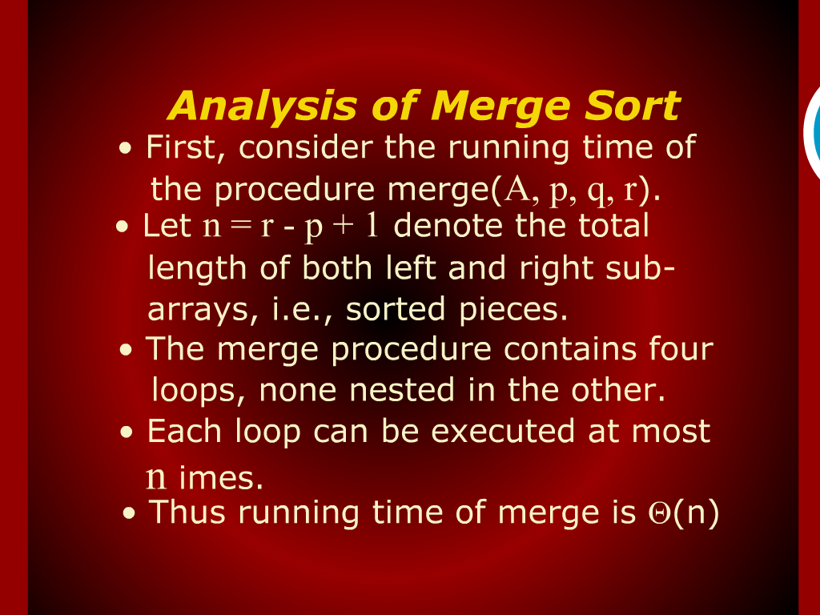
Analysis of Merge Sort

Slide 9
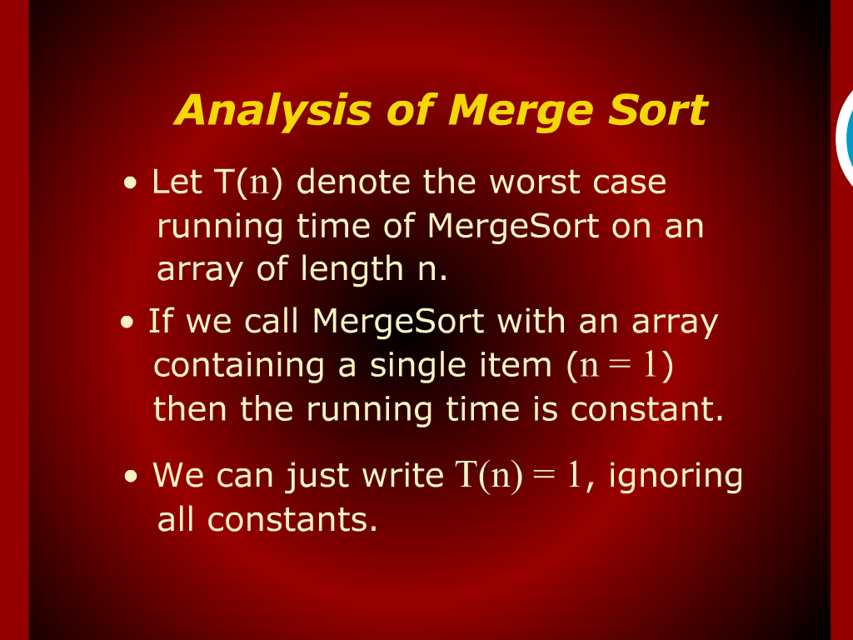
Analysis of Merge Sort

Slide 10
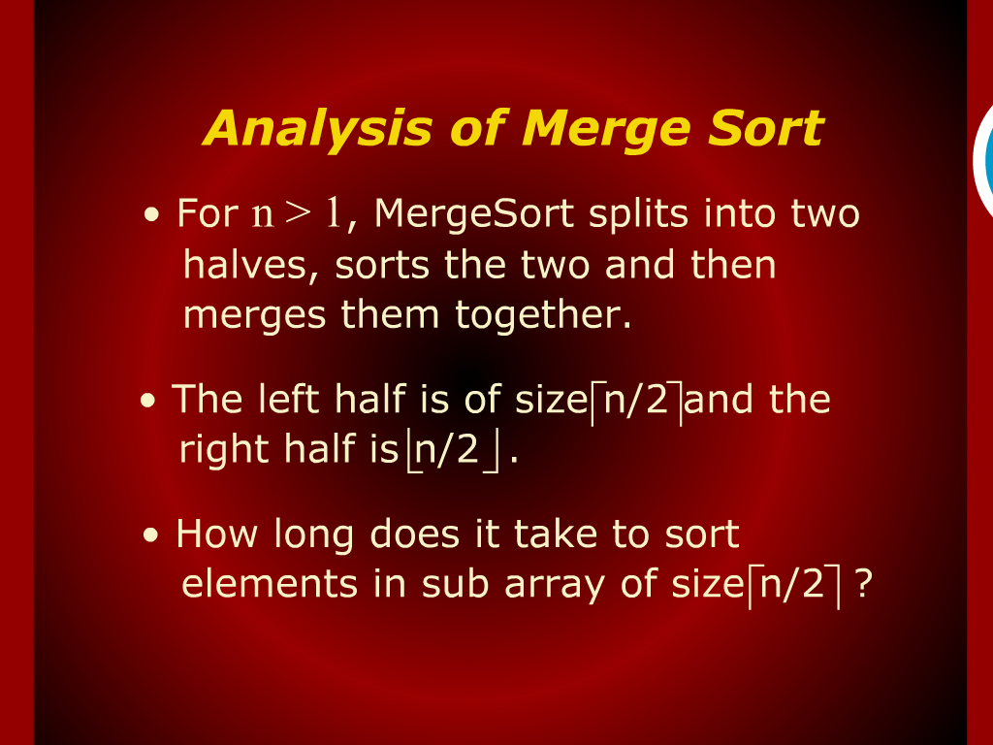
Analysis of Merge Sort

Slide 11
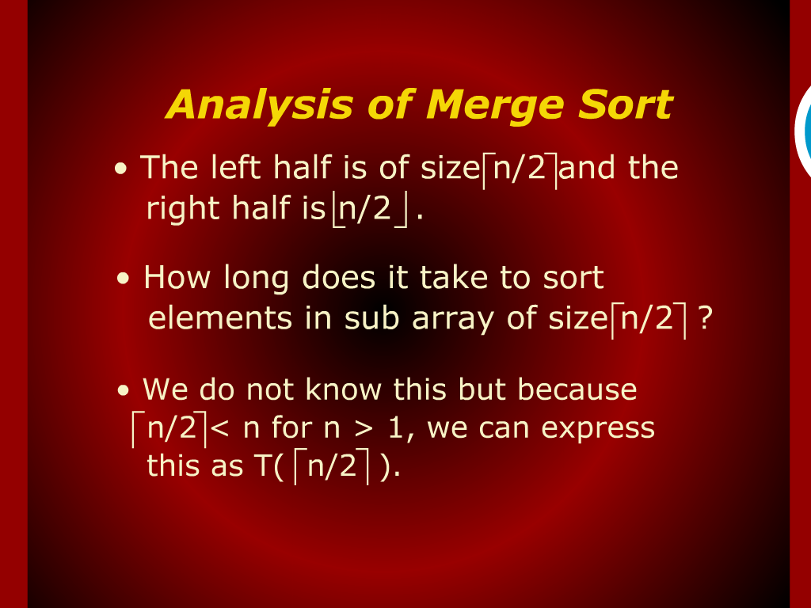
Analysis of Merge Sort

Slide 12
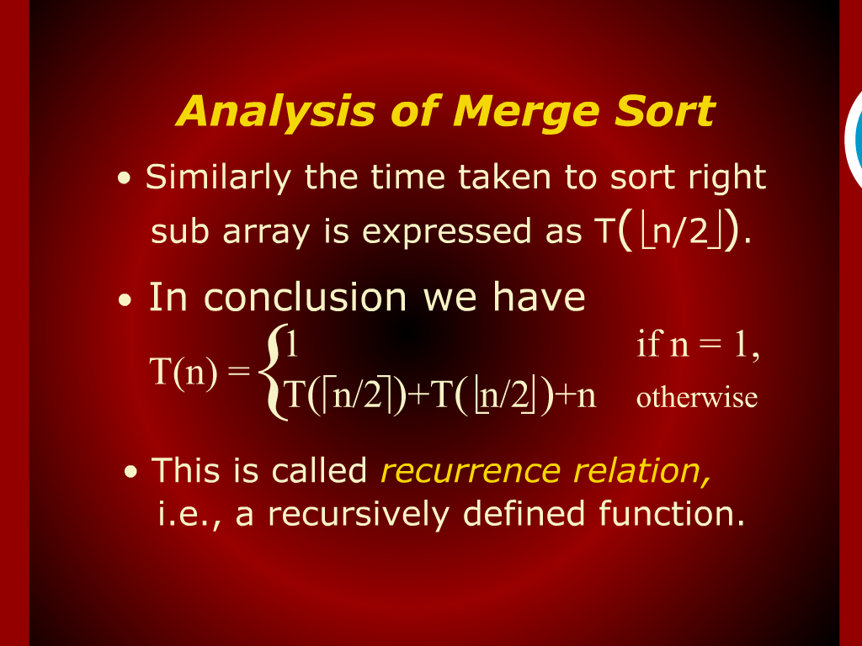
Analysis of Merge Sort

Slide 13
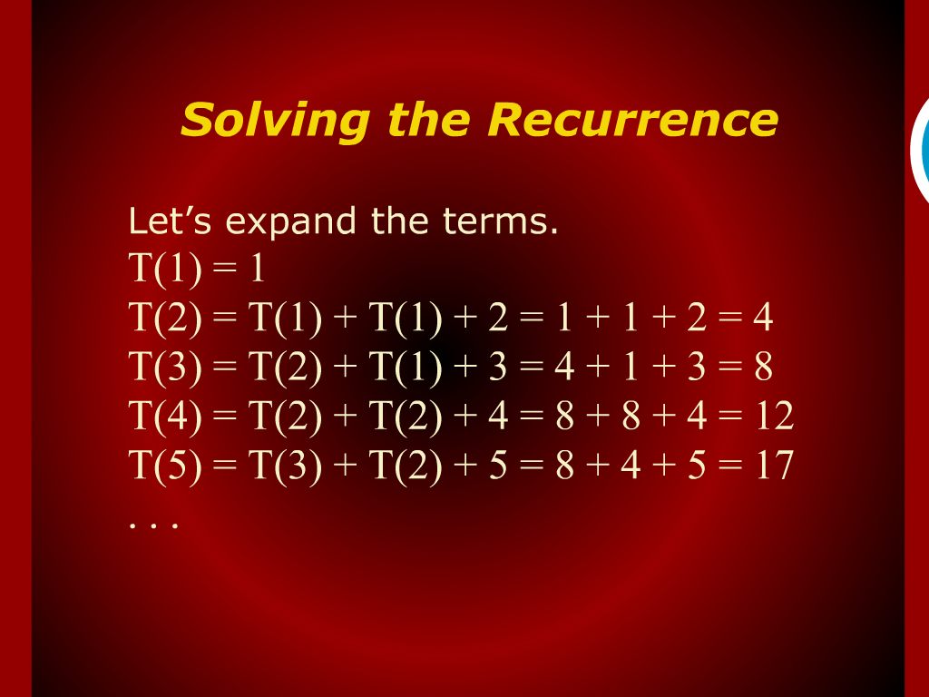
Solving the Recurrence

Slide 14
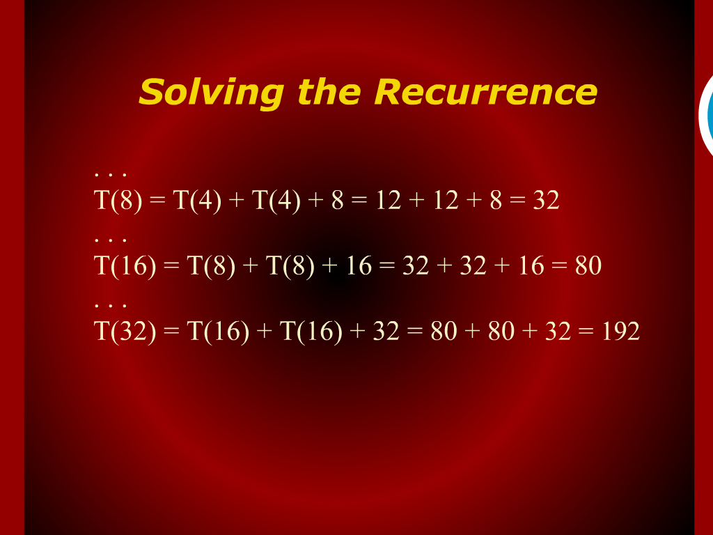
Solving the Recurrence

Slide 15
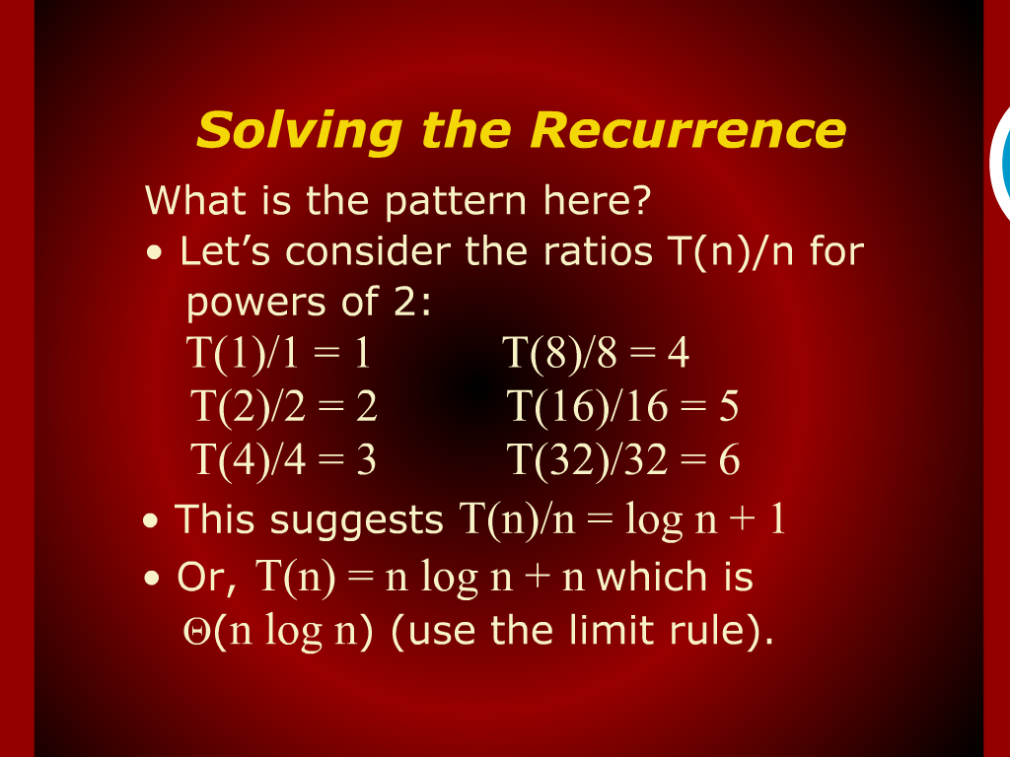
Solving the Recurrence

Slide 16
Solving the Recurrence

Slide 17
Analysis of Merge Sort

Slide 18
Design
and
Analysis of Algorithm

Slide 19
Merge Sort

